Slide 1
HYDROCEPHALOUS
PRESENTED BY:
CHEGE E.M

Slide 2
PHYSIOLOGY
Production-80% choroid plexus,20%parenchymal.
Regulation-neurogenic, pressure alterat.
Resorption-pressure dep. By A villi. Little by sleeves of nn roots.
Flow-next slide.

Slide 3
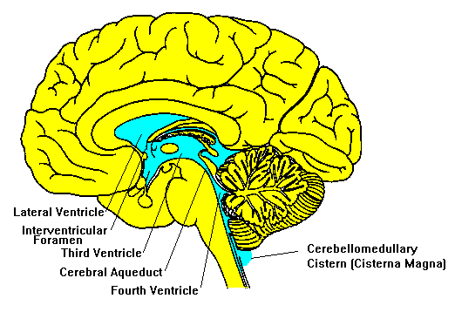
CSF FLOW

Slide 4
PATHOLOGY
Overproduction-chorid plexus papilloma or carcinoma.
Impaired absorpiton-scarring from H’age,or infxn, Villi absent(cong.), altered hydrostatic pressure for absorption.
Obstucted flow-commonest.Malf.,scarring,tumors,infxns, H’age.

Slide 5
AETIOLOGY
Aqueductal Obstruction (Stenosis): The most common cause of congenital hydrocephalus is obstruction of the cerebral aqueduct - the long, narrow passageway between the third and fourth ventricle. Aqueductal obstruction may result from narrowing or blockage of the aqueduct, or may be caused by infection, hemorrhage or a tumor. Fluid accumulates upstream from the obstruction, producing hydrocephalus.
Neural Tube Defects, or Myelomeningocele: Although commonly used, the term "spina bifida" is better replaced by the term "neural tube defect," or NTD. A myelomeningocele is an open NTD wherein the spinal cord is exposed at birth and is often lacking CSF. This form of NTD is associated with widespread abnormalities of the central nervous system, including the Chiari II malformation and hydrocephalus that occur in 90 percent of NTDs. In the Chiari II malformation, part of the cerebellum and the fourth ventricle extend downward through the opening at the base of the skull, blocking the flow out of the fourth ventricle and therefore producing hydrocephalus.
Intraventricular hemorrhage is an acquired form of hydrocephalus and most frequently affects premature newborns. It occurs when small blood vessels lying alongside the ventricular lining rupture. Blood may block or scar the ventricles or may plug the arachnoid villi, the sites of CSF absorption along the sagittal sinus

Slide 6
AETIOLOGY- contd
Meningitis by bacterial infections or, less frequently, viral infections, which can scar
-restricts or obstructs the flow of CSF ventricles or as it passes over the surfaces of the brain in the subarachnoid space.
A head injury can damage the brain's tissues, nerves or blood vessels. Blood from these ruptured vessels may enter the CSF pathways. Because this blood causes inflammation, there may be scarring of the meninges, or blood cells may block the CSF absorptive sites. When this occurs, the CSF flow becomes restricted and hydrocephalus develops.
Tumors: In children, brain tumors most commonly occur in the back of the brain (posterior fossa). As a tumor grows it may fill or compress the fourth ventricle, blocking the flow of spinal fluid. In other areas of the brain a tumor may similarly block or compress the ventricular system, causing hydrocephalus.
Arachnoid cysts are congenital in origin and may occur anywhere in the brain. In children, they are often located in the back of the brain and in the region of the third ventricle. They are CSF-filled cysts that are lined with the arachnoid membrane (one of the three meningeal coverings). Some arachnoid cysts are self-contained, while others may be connected by a passageway with the ventricles or subarachnoid space. The entrapped fluid may block the CSF pathways, producing hydrocephalus.
Dandy-Walker Syndrome: In the Dandy-Walker syndrome, the fourth ventricle is enlarged because of partial or complete closure of its outlets. In addition, a portion of the cerebellum fails to develop. The Dandy-Walker syndrome can be associated with abnormal, or a lack of, development of other parts of the brain as well. Obstruction at the aqueduct may also occur.

Slide 7
CLASSIFICATION
A: Obstructive
Communicating-no obvious obstrn to flow. Ventricles comm. With SA space.
Congenital eg with CNS abn like spina bifida;X linked aqueduct stenosis;intrauterine infxns.
Acquired-eg H’age and infxns like meningitis.

Slide 8
PRESENTATION
INFANTS & CHILDREN
Increasing head circ.
Tense bulging fontanelle
Thin glistening scalp
Distended scalp veins
Failure to thrive & feeding problems
Sunsetting/parinauds sign.
No deficits

Slide 9
PRESENTATION
OLDER CHILDREN & ADULTS
Symptoms of Adult-Onset Hydrocephalus
Headaches
Nausea
Difficulty focusing the eyes
Unsteady walk or gait
Leg weakness
Sudden falls
Irritability
Drowsiness
Personality changes
Seizures
Primary Symptoms of NPH
Gait disturbance (difficulty walking)
Dementia or forgetfulness
Bladder control problems (as the condition progresses)

Slide 10
INVESTIGATIONS
P/E
-Head circ.,wt,ht.
-Dispropotion of head to rest of body.
-Tense fontanelle
-transillumination of head-sev cases.
-cracked pot sign
Xray skull-copper beating, eroded clinoid,suture diasthesis.

Slide 11
INVESTIGATIONS
LP- upto 50cc removed to see if shunting will be helpful.
Ultra/S-patent ant fontanelle. Antenatal dx
CT scan-esp tumors-common in 4th ventricle, craniopharyngiomas 3rd V. Other features-nxt pg.
MRI-tumors esp.
Isotopic cisternography: A test that involves injecting a radioactive isotope into the lower back through a spinal tap. This allows the absorption of CSF to be monitored over a period of time (up to 4 days).
Intracranial pressure monitoring: Monitoring may be able to detect an abnormal pressure or pattern of pressure waves. Monitoring requires insertion of a catheter or small fiber optic cable through the skull into the brain

Slide 12
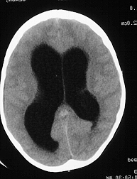
CT SCAN

Slide 13
TREATMENT
MEDICAL
Acetazolamide(Diamox)-red prod by 60%
Frusemide(Lasix)
SURGICAL
Ante natal-Ventriculo-Amniotic Shunt
Surgical resection of cause esp tumor.
External drainage
Bypass-ventriculostomy
Internal diversion-VA,VP,VG.
Comp-malfxn(disconnection,obst.,migration)infxn.

Slide 14
THANK YOU
A FEW QUESTIONS PLEASE!

